Slide 1



Daashboard
View in Power BI
Last data refresh:
8/28/2021 10:56:24 AM UTC
Downloaded at:
8/28/2021 11:04:31 AM UTC

Slide 2
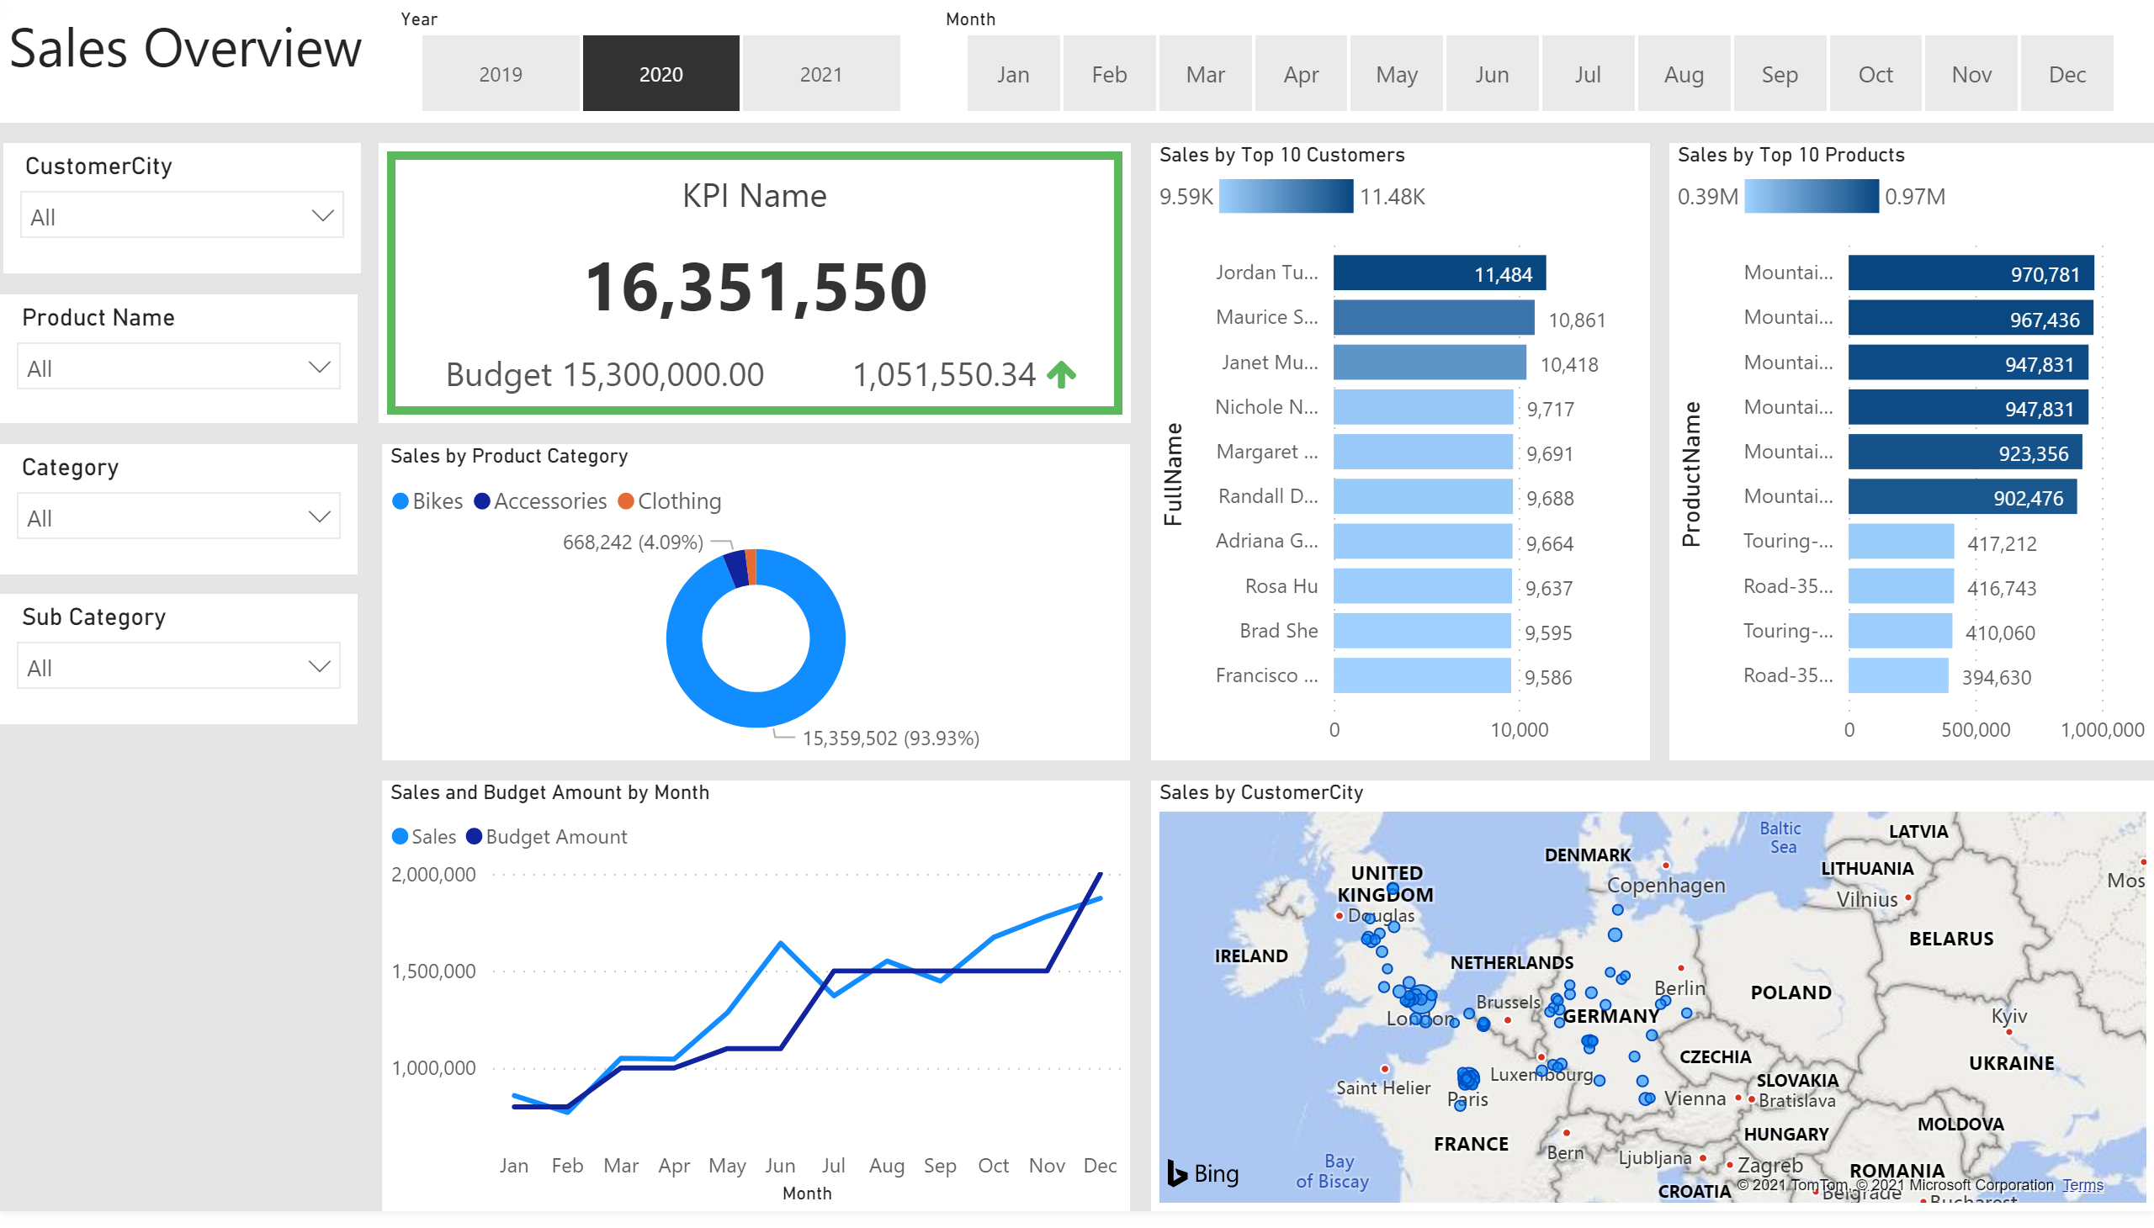
Sales Overview
Notes:
slicer
No alt text provided.
slicer
No alt text provided.
donutChart
No alt text provided.
Sales by Top 10 Products
No alt text provided.
Sales by Top 10 Customers
No alt text provided.
lineChart
No alt text provided.
map
No alt text provided.
textbox
No alt text provided.
slicer
No alt text provided.
slicer
No alt text provided.
slicer
No alt text provided.
slicer
No alt text provided.
BBED0A4D4D8D44CE93CF2DAFADEE466C
No alt text provided.

Slide 3
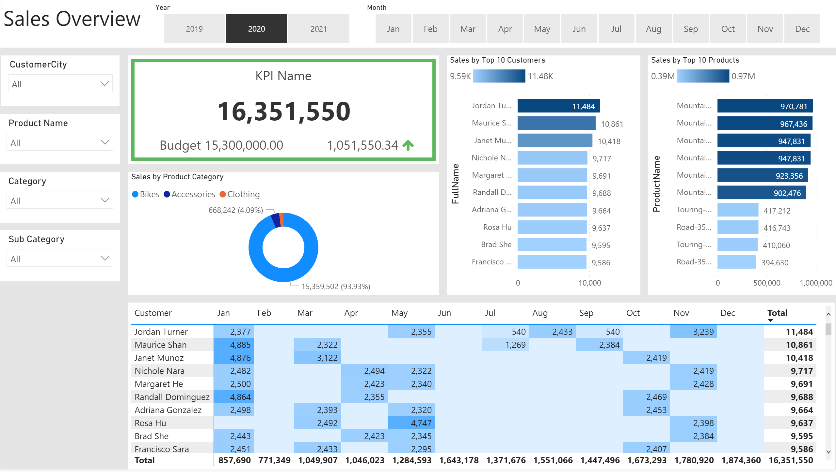
Customer Details
Notes:
donutChart
No alt text provided.
Sales by Top 10 Products
No alt text provided.
Sales by Top 10 Customers
No alt text provided.
slicer
No alt text provided.
slicer
No alt text provided.
pivotTable
No alt text provided.
textbox
No alt text provided.
slicer
No alt text provided.
slicer
No alt text provided.
slicer
No alt text provided.
slicer
No alt text provided.
BBED0A4D4D8D44CE93CF2DAFADEE466C
No alt text provided.

